Slide 2
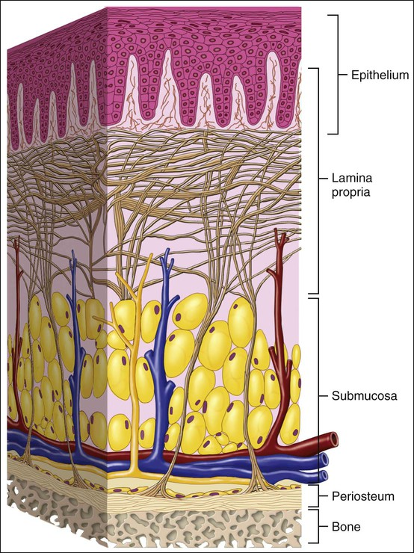
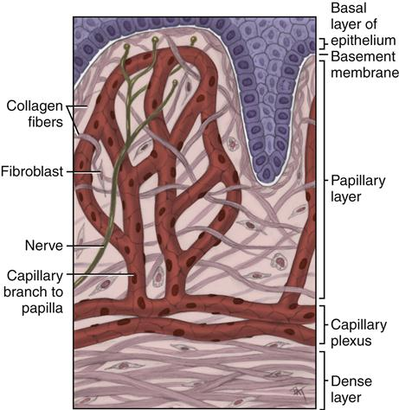
Lamina propria

Slide 3
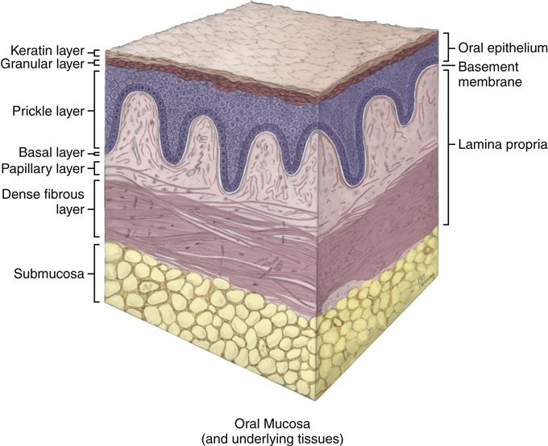

Slide 4
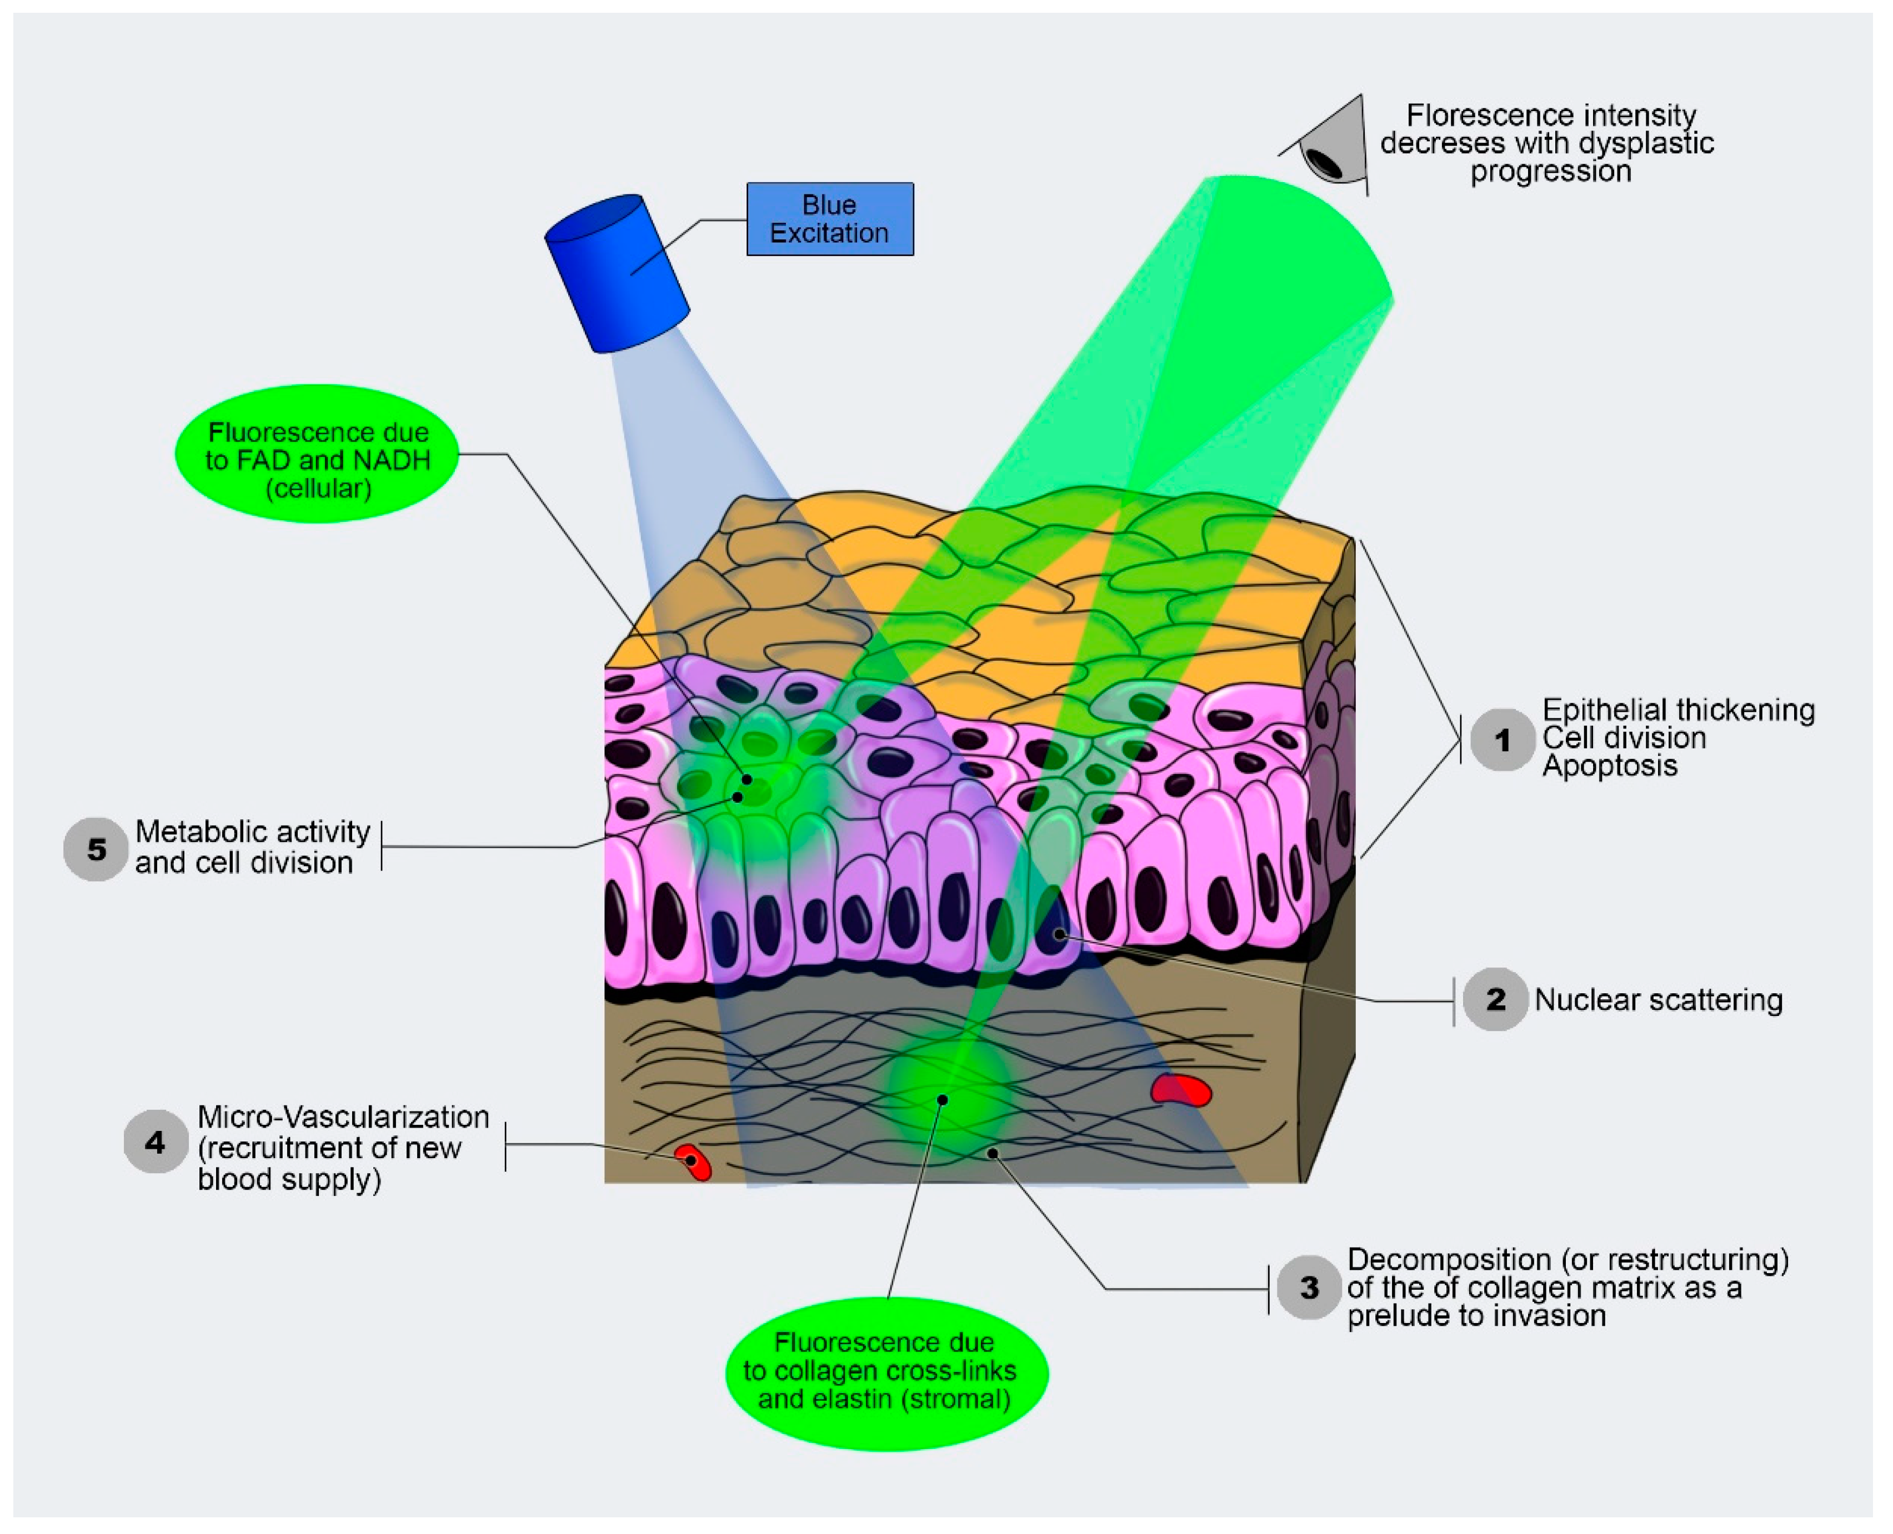

Slide 5
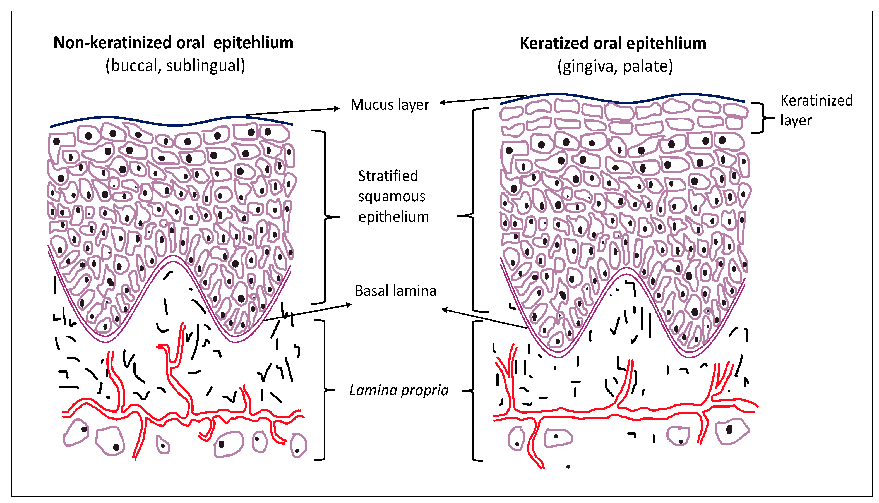
Notes:
Keratin itself is a structural protein and does not contain a nucleus

Slide 6
Dorsal tongue tissue
porphyrins
Inner lip oral mucosal tissue
keratin
FAD
NADH
Collagen
and
Blood

Slide 7
porphyrins
keratin
FAD
NADH
Collagen
and
Blood

Slide 8
Porphyrins
Keratin
FAD
NADH
Collagen Elastin
Blood

